Slide 1
Power Side Channel Attacks on Hardware Wallet to Recover Pins
Presented by : Shubhankar Gambhir
Supervisor : Prof. Urbi Chatterjee

Slide 2
Contents
Introduction
Background
Vulnerability in Trezor-One Firmware
Possible Attack Strategies
Experimental Setup & Results for Emulator
Experimental Setup for Trezor-One
Future Work

Slide 3
Introduction
Hardware wallets such as Trezor are used to store private keys of users so that they are not exposed to attackers, this makes them secure to store funds. Although keys are not directly exposed, there is a possibility of leakage in power consumption when some operations are performed in the wallet, which might make it vulnerable to side-channel attacks. In this work we have built an emulator for trezor firmware using the Rainbow Library and tried to extract its pin using ML attack on simulated power traces, further we have obtained real traces using oscilloscope, using which a similar attack can be performed.

Slide 4
Background
Side Channel Attack: Side-Channel Attack are attacks on devices which depend on the characteristics leaked by those devices (such as time, power, EM waves) during computation, which depend on the data which is manipulated. An attacker can use this leaked information to retrieve sensitive data.
Trezor-One: Trezor one is an open source hardware wallet which used a 4-6 digit PIN to safeguard the private keys stored inside it.

Slide 5
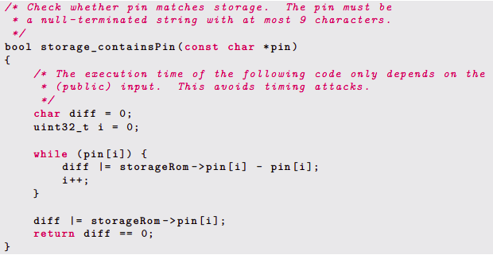
Vulnerability in Trezor-One Firmware
As noted by [1], in the actual pin comparison function of Trezor-one digits are processed one after other and the comparison with pin is done in a deterministic way. So basically, our task is to perform a side-channel attack on each digit of the pin.

Slide 6
Experimental Setup
We conducted 2 experiments
Performing side-channel attack on an emulator for Trezor
Attempting side-channel attack on an actual Trezor-One

Slide 7
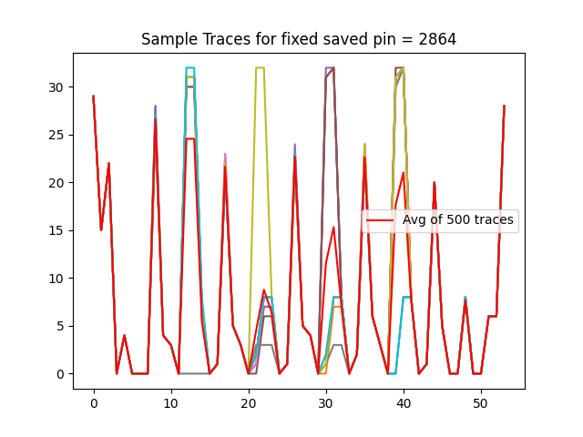
Performing side-channel attack on an emulator for Trezor
We first built an emulator for Trezor.
Next, we tried to extract some extract Traces from the emulator.

Slide 8
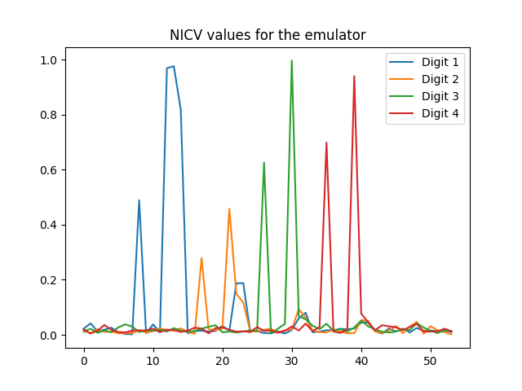
ML Based Side Channel Attack on the Emulator
Upon analysis of these traces we observe the following NICV values
NICV values using difference as class metric

Slide 9
ML Based Side Channel Attack on the Emulator
Trained classifiers for each digit with SVM[2] using linear kernel
Trained with 1500 traces
Always correct predictions when the presented digit is same as the actual stored pin digit.

Slide 10
Pin Retrieval
We use the SVM models that we trained for each digit to retrieve the actual pin, for which we explored three strategies.
Random Pin input strategy
Chosen Pin input strategy
Iterative Pin input strategy

Slide 11
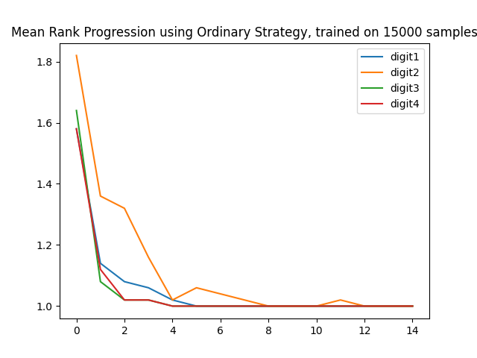
Random Pin Input Strategy
In each trial for Stored Pin:
Generate random input pin
Get Traces for the actual and input pin
Store the predicted probability of each digit
Repeat 1,2,3 for 14 rounds
Finally, Find the most probably digit at each place.
As can be seen, we can get the correct pin in 14 tries.

Slide 12
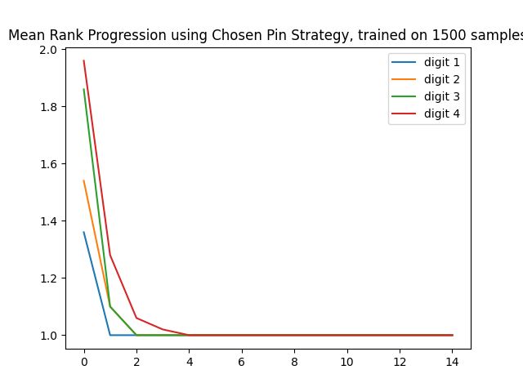
Chosen Pin Strategy
Use First input pin as “5555”
In each trial for Stored Pin:
Get Traces for the actual and input pin
Store the predicted probability of each digit
Use the most probable digits as next input pin.
Repeat 1,2,3 till input == stored pin
As can be seen, we can get the actual pin within 5 tries using the chosen pin strategy

Slide 13
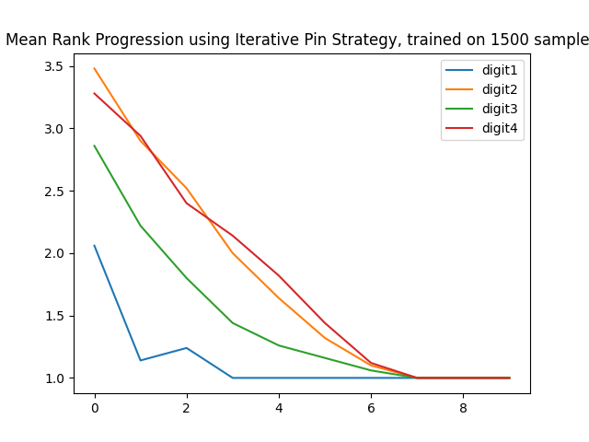
Iterative Pin Strategy
Use First input pin as “1111”
In each trial for Stored Pin:
Get Traces for the actual and input pin
For each index check if the input pin digit is the most probable predicted digit.
If Yes, keep the input pin digit same
Else increment the digit by 1.
Repeat 1,2,3 till input == stored pin (for max 9 trials)
As can be seen, we can get the actual pin within 9 tries using the iterative pin strategy

Slide 14
Attempting Side-Channel Attack on Trezor-One
Next, we decided to perform side-channel attack on an actual Trezor-One Hardware wallet
First we removed the casing from our wallet
We then connected our wallet to an oscilloscope and took some sample readings.
We finally created a method to take periodic readings from the oscilloscope, and save them as csv. Using this we can extract multiple traces after passing a command

Slide 15
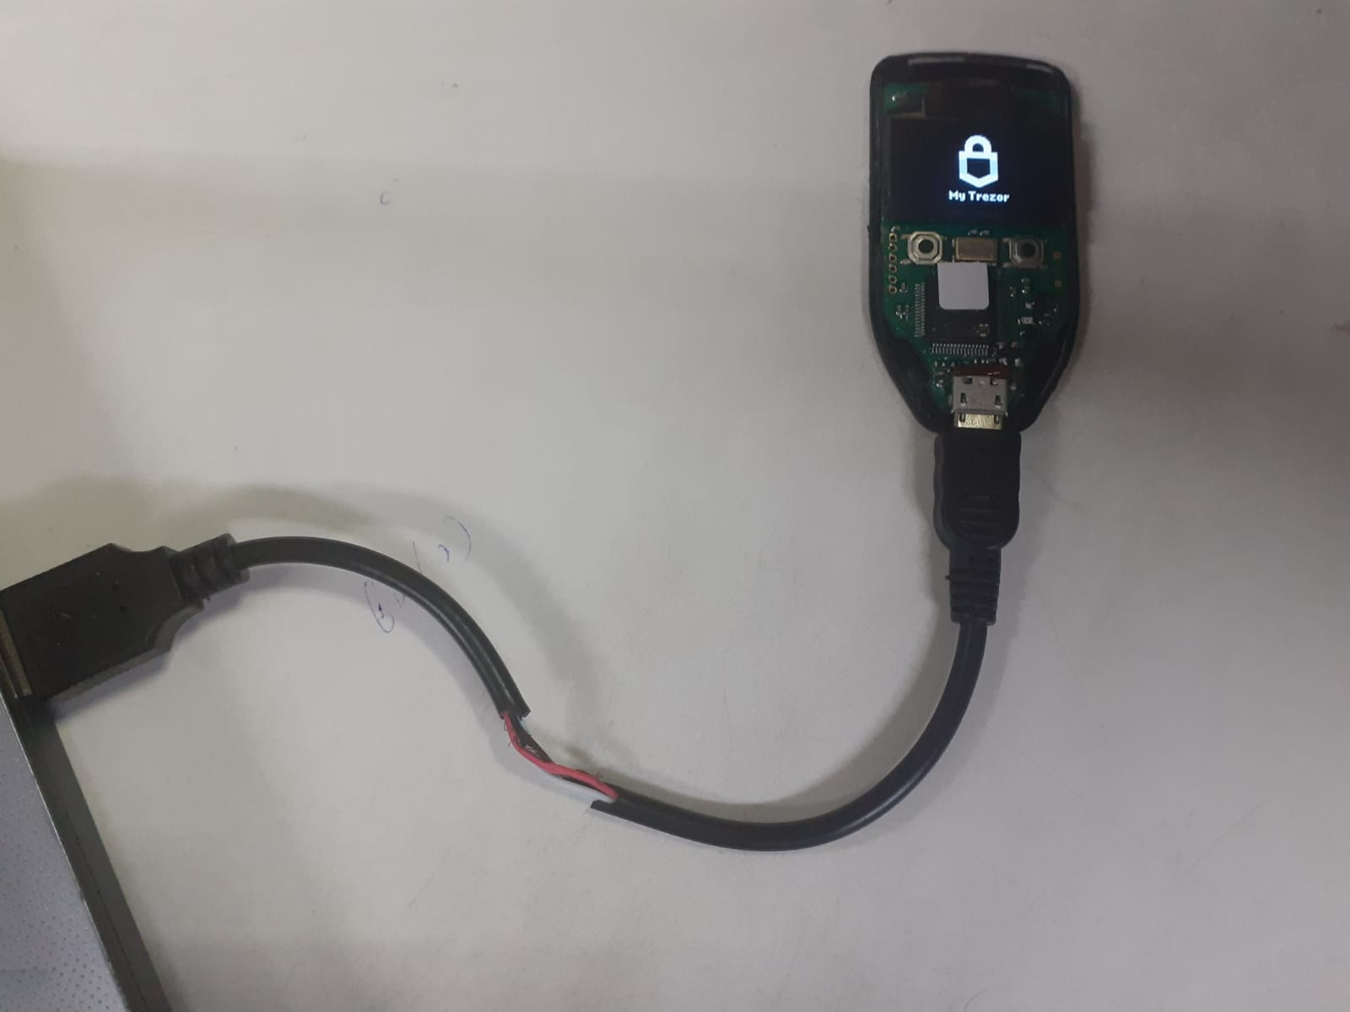
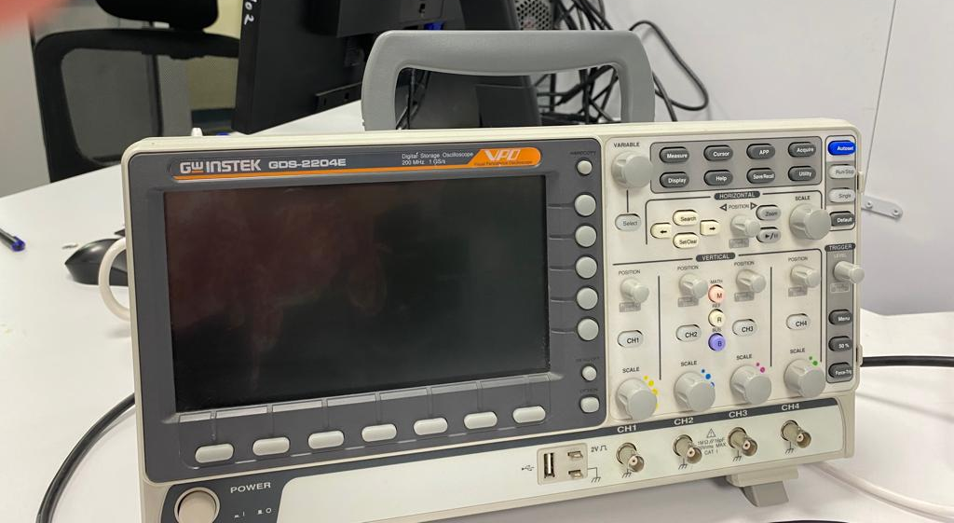
Setup for Trezor-One
An Oscilloscope. 200MHz Frequency, 1GS/a Trezor-One Hardware wallet

Slide 16
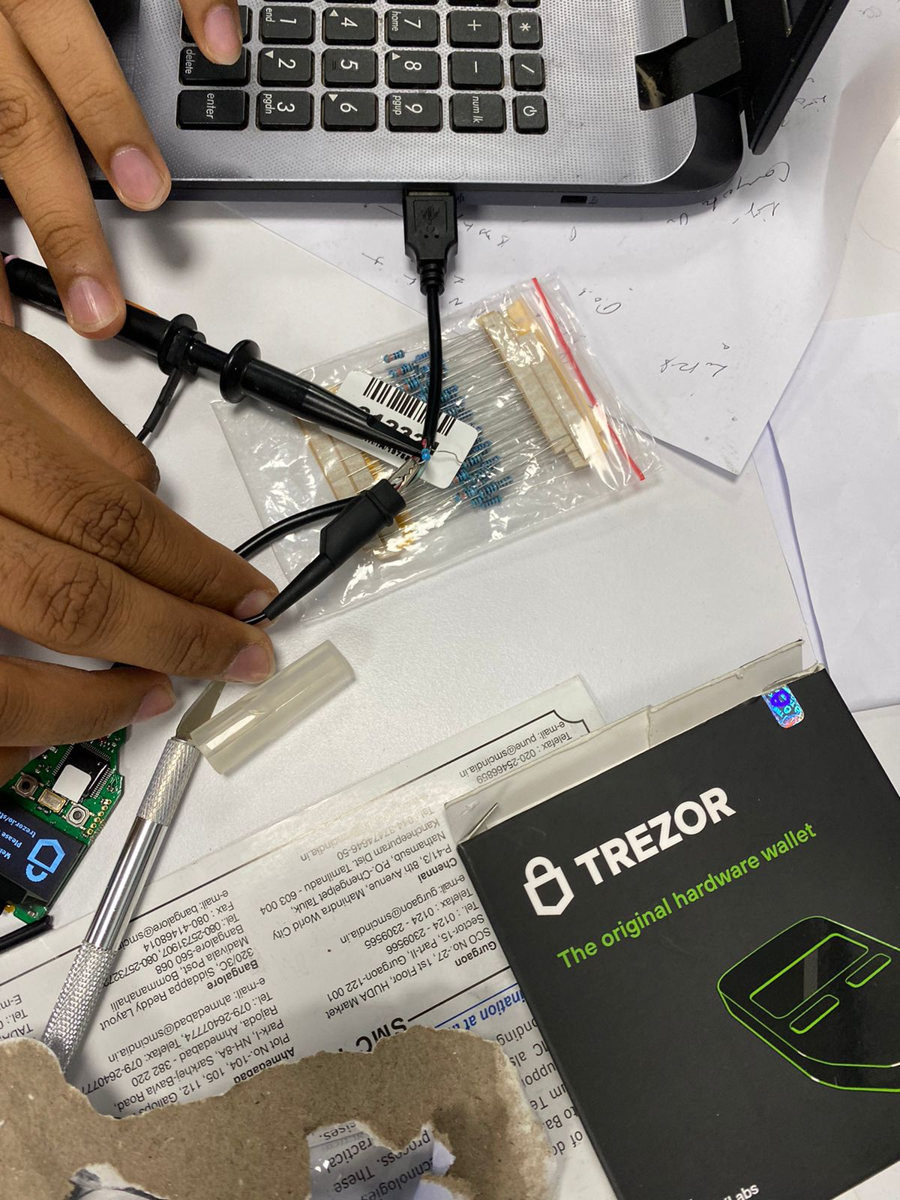
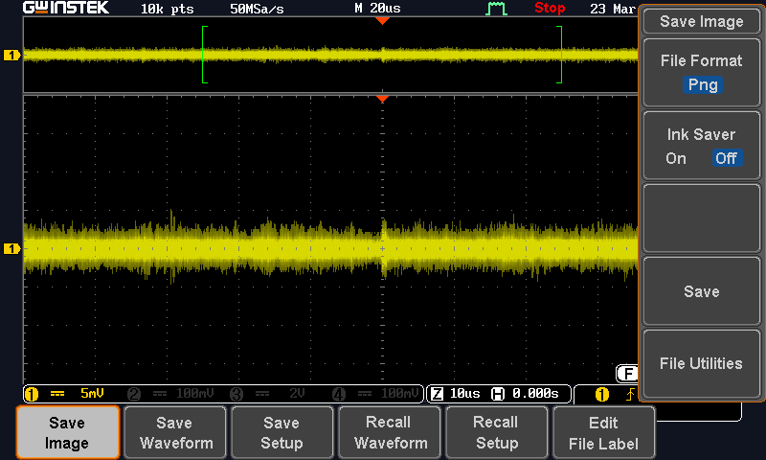
Sample readings from Trezor Taking readings

Slide 17
Future Work
Trigger based trace collection from the oscilloscope
Automating sending triggers to wallet.
Performing similar analysis and checking for possible side channel leakage in the latest Trezor Firmware.

Slide 18
References
https://eprint.iacr.org/2019/401.pdf
https://ieeexplore.ieee.org/document/708428

Slide 19
THANK YOU

